Slide 1
Decrease by a percentage
Understanding multiplicative relationships: percentages and proportionality

Slide 2
how to use Oak lessons

Slide 3
I can calculate percentage changes (decrease).

Slide 4
Proportion is a part to whole (sometimes part to part) comparison. If two things are proportional then the ratio of part to whole is maintained and the multiplicative relationship between parts is also maintained.

Slide 5

Decrease by a percentage
Decreasing an amount by a percentage
Using a multiplier
Mixed percentage change

Slide 6
Decreasing an amount by a percentage
We can use bar models to show a percentage decrease.
Firstly, using square or gridded paper, draw a bar using 10 squares.
This will represent £120
We can indicate that this is 100%
100% = £120

Slide 7
Decreasing an amount by a percentage
Dividing by 10, we find that 10% = 12
10%
12
100% = £120

Slide 8
Decreasing an amount by a percentage
What is a 20% decrease from £120?
120 − 12 × 2 = 96
20%
12
12
100% = £120

Slide 9
Decreasing an amount by a percentage
What is a 20% decrease from £120?
120 − 12 × 2 = 96
20%
£96
12
12
100% = £120

Slide 10
Decreasing an amount by a percentage
Draw a bar model to work out and represent 20 decreased by 30%
30%
a)
2
2
2
Decreasing 20 by 30%
= 20 − 6 =14
100% = 20
Draw a bar model to work out and represent 60 decreased by 45%
45%
b)
3
6
6
6
6
Decreasing 60 by 45%
= 60 − 27 = 33
100% = 60

Slide 11
Decreasing an amount by a percentage
Pair up the equivalent questions:
Decrease 50 by 30%
Work out 80% of 50
Work out 97% of 50
Increase 50 by 45%
Decrease 50 by 20%
Work out 70% of 50
Work out 145% of 50
Decrease 50 by 3%

Slide 12
Decreasing an amount by a percentage
2) Fill in the bar model and missing information to show:
a) 400 decreased by 30% is the same as 70 % of 400
Answer = 280
b) 88 decreased by 20% is the same as 80 % of 88
Answer = 70.4
c) 64 decreased by 35 % is the same as 65% of 64
Answer = 41.6
30%
40 | 40 | 40 | 40 | 40 | 40 | 40 | 40 | 40 | 40
20%
8.8 | 8.8 | 8.8 | 8.8 | 8.8 | 8.8 | 8.8 | 8.8 | 8.8 | 8.8
35%

Slide 13
Decreasing an amount by a percentage
3a) Draw a bar model to work out and represent £124 decreased by 40%
3b) Draw a bar model to work out and represent £72 decreased by 35%

Slide 14
Decreasing an amount by a percentage
Pair up the equivalent questions:
Decrease 50 by 30%
Work out 80% of 50
Work out 97% of 50
Increase 50 by 45%
Decrease 50 by 20%
Work out 70% of 50
Work out 145% of 50
Decrease 50 by 3%

Slide 15
Decreasing an amount by a percentage
2) Fill in the bar model and missing information to show:
a) 400 decreased by 30% is the same as 70% of 400
Answer = 280
b) 88 decreased by 20% is the same as 80% of 88
Answer = 70.4
c) 64 decreased by 35% is the same as 65% of 64
Answer = 41.6
30%
40 | 40 | 40 | 40 | 40 | 40 | 40 | 40 | 40 | 40
20%
8.8 | 8.8 | 8.8 | 8.8 | 8.8 | 8.8 | 8.8 | 8.8 | 8.8 | 8.8
35%
6.4
6.4
6.4
6.4
6.4
6.4
6.4
6.4
6.4
3.2

Slide 16
Decreasing an amount by a percentage
3a) Draw a bar model to work out and represent £124 decreased by 40%
40%
Decreasing £124 by 40%
= 124 − 12.4 × 4
= 74.4
£74.40
12.4
12.4
12.4
£74.40
12.4
100% = £124
3b) Draw a bar model to work out and represent £72 decreased by 35%
35%
Decreasing £72 by 35%
= 72 − 7.2 × 3 − 3.6
= 46.80
£46.80
£46.80
7.2
7.2
7.2
3.6

Slide 17
Decrease by a percentage
Decreasing an amount by a percentage
Using a multiplier
Mixed percentage change

Slide 18
Using a multiplier
Here we have a double number line showing 100% is 450
What is 10% of 450?
10%
100%
0%
Percentage
Amount
0
45
450

Slide 19
Using a multiplier
Here we have a double number line showing 100% is 450
What is 20% of 450?
10%
20%
100%
0%
Percentage
Amount
0
45
90
450

Slide 20
Using a multiplier
What does a 20% decrease of 450 look like on a number line?
− 20%
20%
80%
100%
0%
Percentage
Amount
0
90
360
450
− 90

Slide 21
Using a multiplier
This approach works to find a percentage decrease, but now let’s see how we can use a multiplier given we know there is a multiplicative relationship.
− 20%
80%
100%
0%
Percentage
Amount
0
360
450
− 90

Slide 22
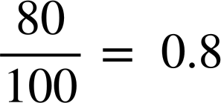

Using a multiplier
To decrease 450 by 20%, what do you think we multiply 100 by to give 80?
The multiplier is
80%
100%
0%
Percentage
Amount
0
360
450

Slide 23
Using a multiplier
The double number line shows a decrease of 120 by 52%. Fill in the missing information.
0.48
× ……..
48
100%
0%
……%
Percentage
0
Amount
57.6
120
……..
0.48
× ……..

Slide 24
Using a multiplier
Removing the double number lines, can you work out the multiplier to decrease any amount by 35%?
× 0.65
65%
100%
Can you explain how to quickly find this multiplier?
Given 35% as a decimal is 0.35 and 100% as a decimal is 1, subtracting, as it is a decrease, gives 0.65
Also, decreasing anything by 35% is the same as working out 65% of a number.

Slide 25
Using a multiplier
Identify the multiplier when any number is:
Decreased by 40%
Decreased by 34%
Decreased by 78%
Decreased by 16%
Decreased by 4%
Decreased by 8%
Decreased by 2.3%
× 0.6
× 0.66
× 0.22
× 0.84
× 0.96
× 0.92
× 0.977

Slide 26
Using a multiplier
1) Match the statements with the calculation.
Work out 84% of 400
Work out 39% of 16
400 × 0.84
Decrease 600 by 14%
Work out 86% of 600
16 × 0.39
Work out 86% of 400
Decrease 400 by 14%
600 × 0.86
Decrease 14 by 16%
Work out 84% of 14
400 × 0.86
Decrease 16 by 61%
Decrease 400 by 16%
14 × 0.84

Slide 27
Using a multiplier
2) Work out the amount of money when £94 has been decreased by 47%
3) Work out the amount of money when £162 has been decreased by 28%
👕
4) A T-shirt was reduced by 24% in a sale.
How much is the T-shirt now?
T-shirt £25

Slide 28
Using a multiplier
1) Match the statements with the calculation.
Work out 84% of 400
Work out 39% of 16
400 × 0.84
Decrease 600 by 14%
Work out 86% of 600
16 × 0.39
Work out 86% of 400
Decrease 400 by 14%
600 × 0.86
Decrease 14 by 16%
Work out 84% of 14
400 × 0.86
Decrease 16 by 61%
Decrease 400 by 16%
14 × 0.84

Slide 29
Using a multiplier
2) Work out the amount of money when £94 has been decreased by 47%
3) Work out the amount of money when £162 has been decreased by 28%
94 × 0.53 = 49.82
162 × 0.72 = 116.64
👕
4) A T-shirt was reduced by 24% in a sale.
How much is the T-shirt now?
T-shirt £25
£25 × 0.76 = £19

Slide 30
Decrease by a percentage
Decreasing an amount by a percentage
Using a multiplier
Mixed percentage change

Slide 31
Mixed percentage change
Double number lines are excellent visual tools to see a percentage increase.
For example,
Increasing any number by 35% we simply multiply by 1.35
For example,
Decreasing any number by 59% we simply multiply by 0.41
× 1.35
100%
135%
× 0.41
41%
100%

Slide 32
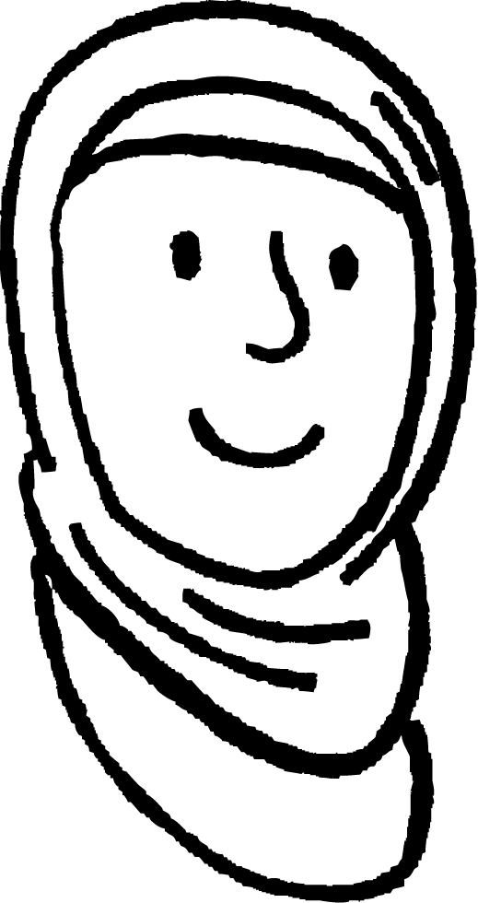
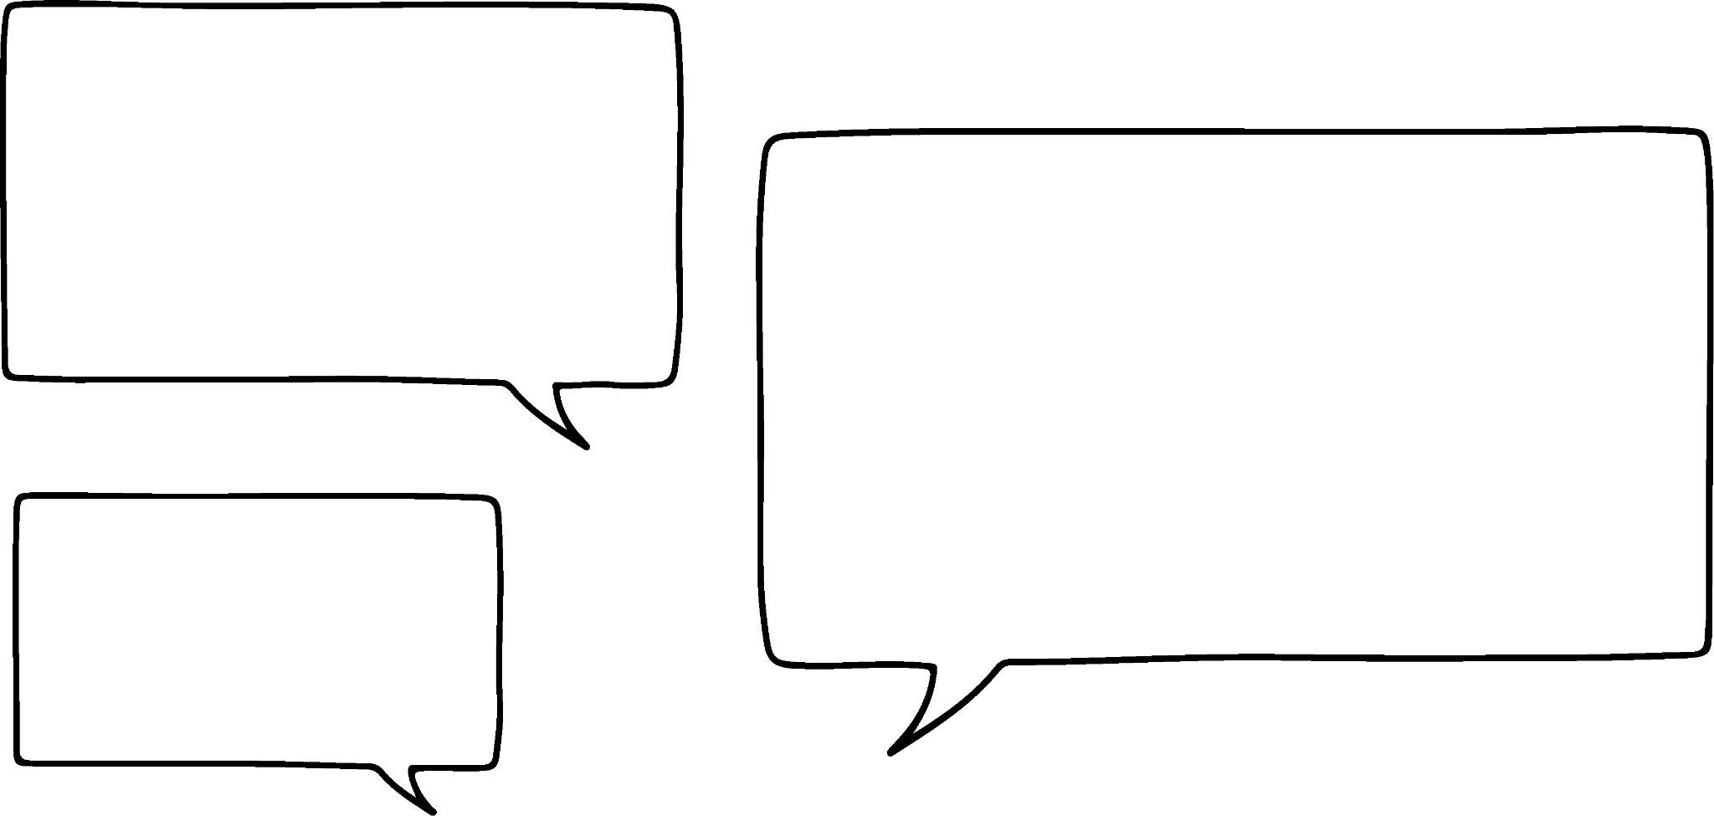
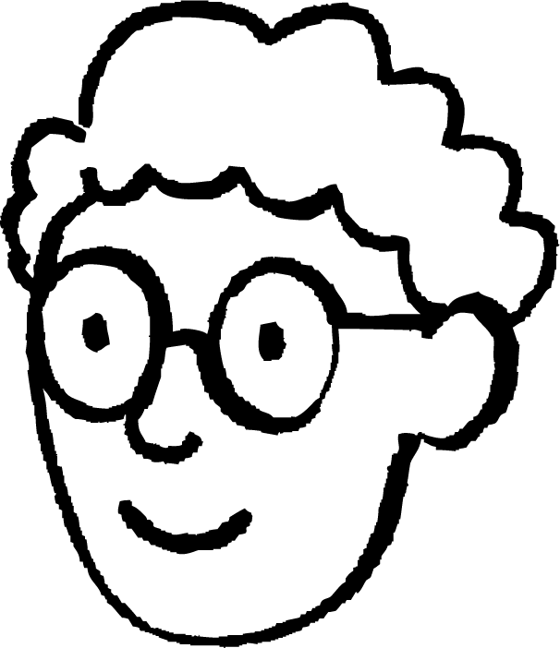
Mixed percentage change
Increasing by 35% we multiply by 1.35
When I increase, I add the percentage as a decimal to 1
× 1.35
Aisha
100%
135%
When I decrease, I subtract the percentage as a decimal from 1
Decreasing by 59% we multiply by 0.41
× 0.41
Alex
Can you explain why this works?
41%
100%

Slide 33
Mixed percentage change
Increasing by 35% we multiply by 1.35
When I increase, I add the percentage as a decimal to 1
× 1.35
Aisha
100%
135%
The original amount is always 100% or 1 as a decimal, so increasing any amount by any percentage simply means you are adding the decimal equivalent to 1
Decreasing by 59% we multiply by 0.41
× 0.41
41%
100%

Slide 34
Mixed percentage change
The original amount is always 100% or 1 as a decimal, so decreasing any amount by any percentage simply means you are subtracting the decimal equivalent from 1
Increasing by 35% we multiply by 1.35
× 1.35
100%
135%
When I decrease, I subtract the percentage as a decimal from 1
Decreasing by 59% we multiply by 0.41
× 0.41
Alex
41%
100%

Slide 35
Mixed percentage change
Identify the multiplier when any number is:
Increased by 40%
Decreased by 34%
Increased by 78%
Decreased by 16%
Increased by 4%
Increased by 8%
Decreased by 3.2%
× 1.4
× 0.66
× 1.78
× 0.84
× 1.04
× 1.08
× 0.968

Slide 36
Mixed percentage change
Pair up the statement with the calculation and the answer.
Increase 400 by 80%
Decrease 600 by 25%
600 × 0.75
80
Work out 75% of 600
400 × 1.8
720
Decrease 400 by 80%
400 × 0.2
450
Work out 20% of 400

Slide 37
Mixed percentage change
Tick the calculations that correctly represent each statement.
Statement | Calculation | Tick
Increase £20 by 35% | 20 × 1.35
Decrease £20 by 35% | 20 × 0.35
Increase £35 by 20% | 35 × 0.2
Decrease £35 by 20% | 35 × 0.8
Increase £45 by 1% | 45 × 1.1
Decrease £45 by 1% | 45 × 0.99

Slide 38
Mixed percentage change
2a) Aisha has £20 to buy a present for her dad. There is a sale on at the shop. Below are some items with their original prices and the discounts to be applied. Which of the items can she afford?
Shorts £30
T-shirt £25
Jacket £50
Hat £22
Scarf £22
🩳
👒
👕
🧥
🧣
10% off
20% off
50% off
50% off
15% off
b) For those she can’t afford, what discounts would she need so that she can afford any item in the shop?

Slide 39
Mixed percentage change
3) Laura says,
“If you increase an amount by 13% and then decrease it by 13% you get the same value you started with.”
Explain whether Laura is correct.

Slide 40

Mixed percentage change
Tick the calculations that correctly represent each statement.
Statement | Calculation | Tick
Increase £20 by 35% | 20 × 1.35
Decrease £20 by 35% | 20 × 0.35
Increase £35 by 20% | 35 × 0.2
Decrease £35 by 20% | 35 × 0.8
Increase £45 by 1% | 45 × 1.1
Decrease £45 by 1% | 45 × 0.99

Slide 41
Mixed percentage change
2a) Aisha has £20 to buy a present for her dad. There is a sale on at the shop. Below are some items with their original prices and the discounts to be applied. Which of the items can she afford?
Shorts £30
T-shirt £25
Jacket £50
Hat £22
Scarf £22
🩳
👒
👕
🧥
🧣
10% off
20% off
50% off
50% off
15% off
Aisha can afford the T-shirt, scarf or the hat.
b) For those she can’t afford, what discounts would she need so that she can afford any item in the shop?
Aisha would need these discounts: Shorts: a minimum of a 33.33% (2 d.p.) discount.
Jacket: a minimum of 60% discount.

Slide 42
Mixed percentage change
3) Laura says,
“If you increase an amount by 13% and then decrease it by 13% you get the same value you started with.”
Explain whether Laura is correct.
Laura is not correct. It can be explained in a few different ways: Increasing an amount by 13% then gives you a new, different amount. This new, different amount is then regarded as 100%, thus finding 13% of this new, different amount is not the same as 13% of the original amount.
Using multipliers, an amount increased by 13% then decreased by 13% is the same as × 1.13 × 0.87. Using the associative law, this is the same as × 0.9831 This means the final answer is 98.31% of the original amount.

Slide 43
Decrease by a percentage
We have looked at different representations of percentage increase and decrease; bar models and double number lines. Both are helpful visual approaches to work out the increase.
However, using a multiplier is a good approach to work out any percentage decrease or increase.
It is important to remember the same question can be asked, but in different ways, e.g. Decrease 70 by 12% is the same as 88% of 70

Slide 44

© Oak National Academy 2024.
Produced in partnership with Mathematics in Education and Industry.
Licensed on the Open Government Licence v3.0, except where otherwise stated. See Oak terms and conditions.

